Slide 1
Introduction to Java
AIM:
To equip students with fundamentals of Java Programming.

Slide 2
Introduction to Java
Objectives:
The Objectives of this module are:
Explain the features in java
Explain classes and objects
Illustrate various operators in Java
Illustrate keywords, variables and data types in Java
Explain the use of string
Demonstrate different control statements in Java
Discuss declaration, definition and calling of methods in Java
Describe arrays in java

Slide 3
Introduction to Java
Outcome:
At the end of this module, you are expected to:
Differentiate between the features of Java and other language.
Explain use of JRE and JDK, byte code and JVM.
Write simple Java program.
Describe the basics of classes and objects.
Describe the role of operators in java with example.
Manipulation of String in Java.
Develop programs to demonstrate different operators in Java.
Create a program to illustrate the concept of passing an array to method.

Slide 4
Introduction to Java
Table of Contents
Introduction to Java
Installation of Java
Data types
Operators
Access specifiers
Typecasting
Control Statement
Methods
Arrays

Slide 5
Introduction to Java
Introduction to java
James Gosling, Mike Sheridan, and Patrick Naughton initiated the Java language project in June 1991.
Originally designed for small, embedded systems in electronic appliances like set-top boxes.
Firstly, it was called "Greentalk" by James Gosling and file extension was .gt.
After that, it was called Oak and was developed as a part of the Green project.

Slide 6
Introduction to Java
Why Java is important?
Trouble with C/C++ is that they are not portable and not platform independent language.
Emergence of World Wide Web, which demanded portable language.
Portable and security necessitated the invention of java.

Slide 7
Introduction to Java
What is Java?
A general purpose object oriented language.
Write once run anywhere.
Automatic memory management.
Designed to easy web/ internet application.
Widespread acceptance.

Slide 8
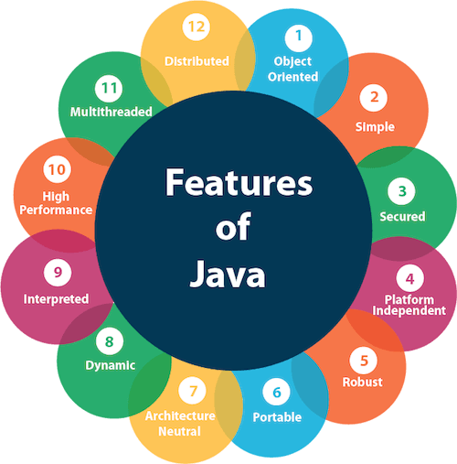
Introduction to Java
Features of Java
Simple
Object-Oriented
Portable
Platform independent
Secured
Robust
Architecture neutral
Interpreted
High Performance
Multithreaded
Distributed
Dynamic

Slide 9
Introduction to Java
Installation of Java
Step 1: Download JDK
Step 2: Install JDK and JRE
Step 3: Include JDK's "bin" Directory in the PATH
Step 4: Verify the JDK Installation
Step 5: Write a Hello-World Java Program
Step 6: Compile and Run the Hello-World Java Program

Slide 10
Introduction to Java
Java Virtual Machine (JVM)
JVM (Java Virtual Machine) is an abstract machine.
It is a specification that provides runtime environment in which java bytecode can be executed.
The JVM performs following operation:
Loads code
Verifies code
Executes code
Provides runtime environment

Slide 11
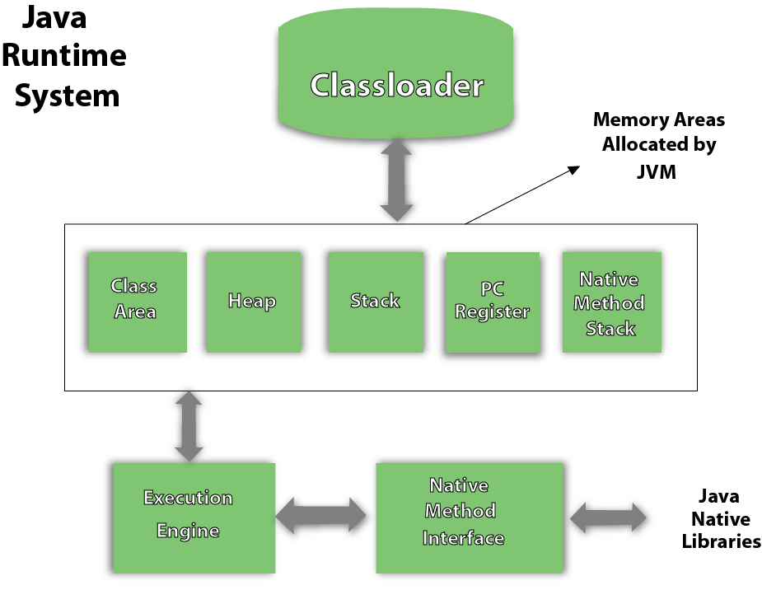
Introduction to Java
JVM Architecture

Slide 12
Introduction to Java
Byte Code
Byte codes are the machine language of the Java virtual machine.
When a JVM loads a class file, it gets one stream of byte codes for each method in the class.
Byte code streams are stored in the method area of JVM.
Source Code
Java Virtual Machine (JVM)
Java Complier
Operating System (OS)
Byte Code

Slide 13
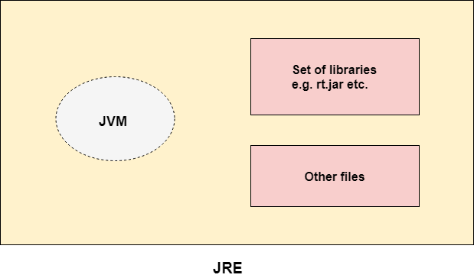
Introduction to Java
Java Runtime Environment (JRE)
The Java Runtime Environment is a set of software tools which are used for developing java applications.
It is used to provide runtime environment.

Slide 14
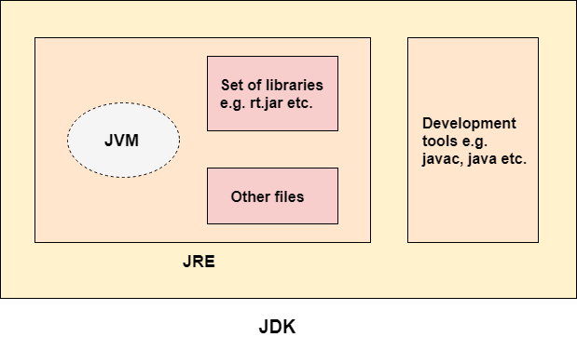
Introduction to Java
Java Development Kit (JDK)
The Java Development Kit (JDK) is a software development environment which is used to develop java applications and applets.
It contains JRE + development tools.

Slide 15
Introduction to Java
Simple Java Program:
import java.util.*
public class Simple
{
public static void main(String args[])
{
System.out.println(“Welcome");
}
}
Compilation: javac Simple.java
Execution: java Simple

Slide 16
Introduction to Java
Self Assessment Questions
Select all the features of Java:
Object oriented
Compiled
Memory management
Multiple inheritance
Scripting language
Answer:

Slide 17
Introduction to Java
Self Assessment Questions
What is a Java compiler?
The part of Java that tells the computer to execute your code.
The resulting file when your source code is translated into machine code.
The part of Java that translates your source code into machine code.
The results of running a java program.
Answer:

Slide 18

Introduction to Java
Document Links
Topics | URL | Notes
Features of java | https://www.sitesbay.com/java/features-of-java | It gives detailed explanation of features of Java
Java installation | https://www3.ntu.edu.sg/home/ehchua/programming/howto/JDK_Howto.html | This link will provide installation guide for java in windows and mac OS
JRE,JDK,JVM | https://www.javatpoint.com/difference-between-jdk-jre-and-jvm | This link provides detailed view of java libraries and environment

Slide 19

Introduction to Java
Video Links
Topics | URL | Notes
Introduction to Java Installation of Java | https://www.youtube.com/watch?v=r59xYe3Vyks | It provide detailed explain for installing java.
JVM,JDK and JRE | https://www.youtube.com/watch?v=RYd_hagCiVk | It provide better to understanding in differences between JVM vs JRE vs JDK in java in one video

Slide 20

Identifier
It is a name given to a class, variable, constant or method.
Rules for Declaring a Legal Identifier:
Identifier must start with a letter, $, _. Cannot start with number.
After the first letter, contain numeric.
No Limit to the number of characters an identifier can contain.
Cannot use keyword in identifier name.
Identifiers are case-sensitive.

Slide 21
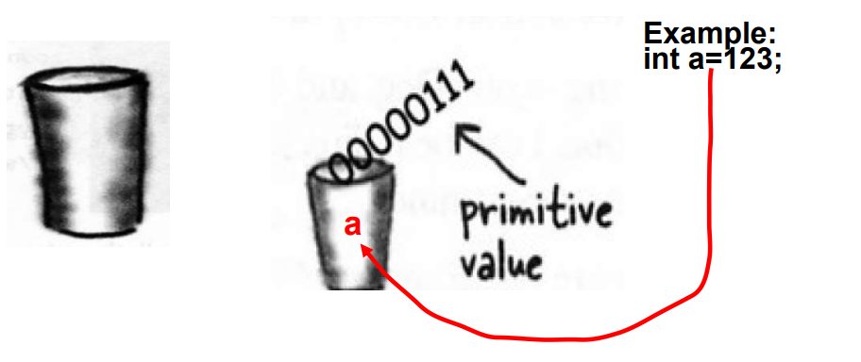
Variable
Variable definitions :A variable is just like a cup or container. It can hold something. It has a size and a type.
Variable: name of place in memory that can contain data
All variables have:
Data type → kind of data variable can contain
Name → identifier that refers to the variable
Value → the default or specified value
also called the literal of the statement
Semicolon
Remember: All java statements end with a semicolon!
e.g.
String s = “MC697”;
int count = 5;

Slide 22
Data Types in Java
Variable (Cup) can be of two type
✔Primitive Type
✔Reference Type
Primitive Type – Primitives are like the cups at the Coffee-House They come in different sizez
Reference type A Reference variable holds bits that represents a way to access an object. It doesn't hold the object itself, but it holds something like a pointer, or an address.different sizes and each has name like small , big, medium.

Slide 23
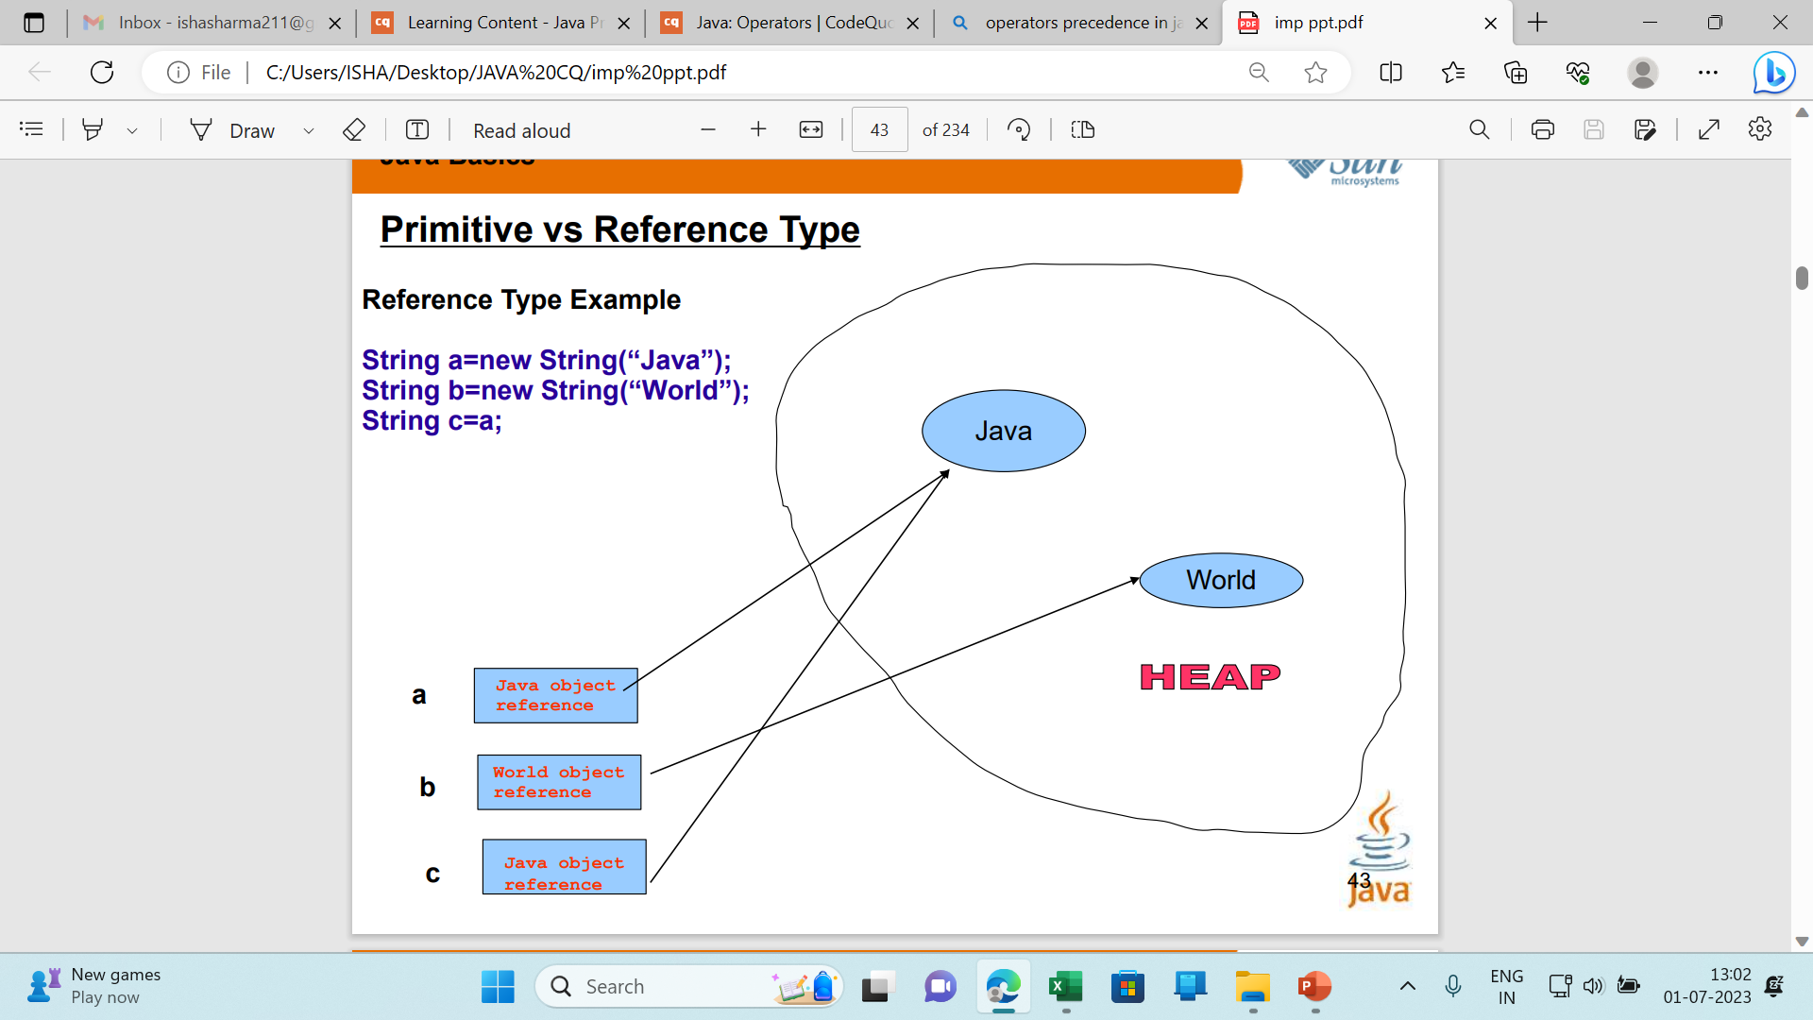
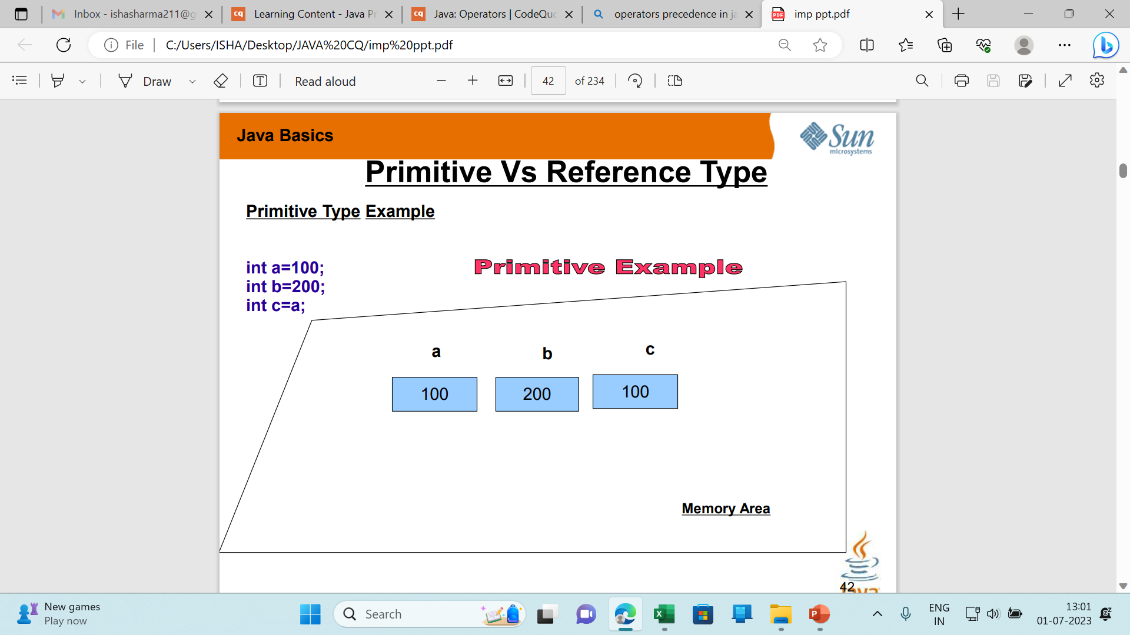

Slide 24
Using == with primitive type
Example
int a=100;
int b=100;
System.out.println(a==b);
//print true
Using == with reference type
Example:
String a=new String(“Hello”);
String b=new String(“Hello”);
System.out.println(a==b);
// false
Why ???
Answer is, The reference type checks address in this case , it return true if both address or references are same.
So HOW I COMPARE VALUES IN REFERENCE TYPE, BECAUSE == CHECKS ADDRESS NOT VALUE?
Answer is using equals() System.out.println(a.equals(b)); //return true

Slide 25
Introduction to Java
Data types in java
Data types specify the different sizes and values that can be stored in the variable.
There are two types of data types in Java:
Primitive data types: The primitive data types include Integer, Character, Boolean, and Floating Point.
Non-primitive data types: The non-primitive data types include Classes, Interfaces, and Arrays.

Slide 26
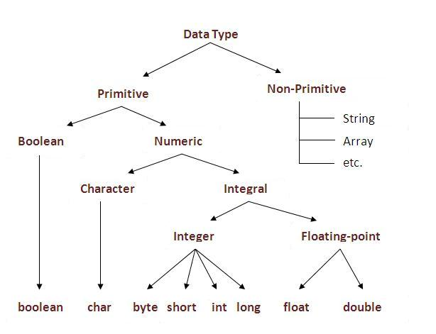
Introduction to Java
Primitive and Non primitive data types

Slide 27
JAVA Primitive Data Types-Strongly Typed-Statically Typed Language
Data Type | Width in bits | Range
byte | 8 bit signed integer | -128 to 127
short | 16 bit signed integer | -32768 to 32767
int | 32 bit signed integer | -2,147,483,648 to 2,147,483,647
long | 64 bit signed integer | -9,223,372,036,854,775,808 to- 9,223,372,036,854,775,807
float | 32 bit floating point number | + 1.4E-45 to + 3.4028235E+38
double | 64 bit floating point number | + 4.9E-324 to + 1.7976931348623157E+308
boolean | true or false | NA, note Java booleans cannot be converted to or from other types
char | 16 bit, Unicode | **Unicode character, \u0000 to \uFFFF Can mix with integer types
**Unicode defines a fully international character set that can represent all of the characters found in all human languages.

Slide 28
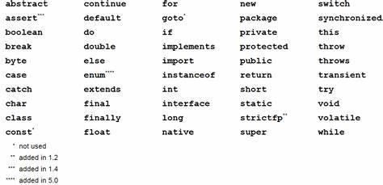
Java Keywords
Keywords or Reserved words are the words in a language that are used for some internal process or represent some predefined actions. These words are therefore not allowed to use as variable names or objects. If we do we will get a compile-time error

Slide 29
Introduction to Java
Self Assessment Questions
Select all of the following expressions that correctly associate a piece of data with their appropriate data type:
1.0 is an int
1.0 is a double
456 is an int
'd' is a char
"abcde" is a char;
"true" is a boolean;
Answer:

Slide 30
Introduction to Java
Document Links
Topics | URL | Notes
Datatypes | http://www.tutorialspoint.com/java/java_basic_datatypes.htm | This link provides detailed explanation of all datatypes with example.
Primitive and non primitive datatypes | https://www.newtutorialslab.com/2015/11/difference-between-primitive-and-non-primitive-data-type.html | This link provide difference between primitive and non primitive datatypes

Slide 31
Introduction to Java
Video Links
Topics | URL | Notes
Datatypes in java | https://www.youtube.com/watch?v=bqPIWlnjWbA | This videos explains about primitive and non primitive datatypes.

Slide 32
Introduction to Java
Operators in Java
An operator is a symbol that performs arithmetic operation.
An operator acts on some variables, called as operands to get the desired result.
Types of operators:
Arithmetic operator
Relational operator
Bitwise operator
Logical operator
Assignment operator
Ternary operator

Slide 33
Introduction to Java
Arithmetic operator
It is used to perform mathematical expression.
It takes numerical expression as their operands and return a single value as a result.
Operators | Symbol
Addition , Subtraction | + , -
Multiplication, Division | * , /
Modulus | %
Increment, Decrement | ++ , - -
Addition assignment | +=
Multiplication assignment | *=
Subtraction assignment | -=
Division assignment | /=
Modulus assignment | %=

Slide 34
Introduction to Java
Relational Operators:
Relational operators are used to check relation between two variables.
They are also used comparison operators since the outcome will be true or false.
Some of relational operators are:
Operators | Result
~ | Bitwise unary NOT
& | Bitwise AND
>> , << | Shift left, Shift right
>>=, <<= | Shift right assignment, shift left assignment
^ | Bitwise exclusive OR

Slide 35
Introduction to Java
Bitwise Operator
Binary operator treat their operands as a sequence of bits rather than as decimal, hexadecimal, or octal numbers.
For example: Decimal number 9 has a binary representation of 1001.
Java defines some bitwise operators that can be implemented to int ,long, short, char and byte.

Slide 36
Introduction to Java
Assignment operators
The assignment operators is the operator is the individual equals, =.
It’s general form is var = expression.
Operators | Name
= | Simple assignment operator.
+= | Add AND assignment operator
-= | Subtract AND assignment operator.
*= | Multiply AND assignment operator
/= | Divide AND assignment operator.

Slide 37
Introduction to Java
Logical operators
Logical operators are used to construct compound conditions. A compound condition is a combination of several simple conditions.
Logical operators are of three types:
&& and operator
| |or operator
not operator
Ternary operator
This operator is called ternary because it acts on 3 variables.
The other name for this operator is conditional operator, since it represents a conditional statement.
Its syntax is variable = expression l expression2 expression3.

Slide 38
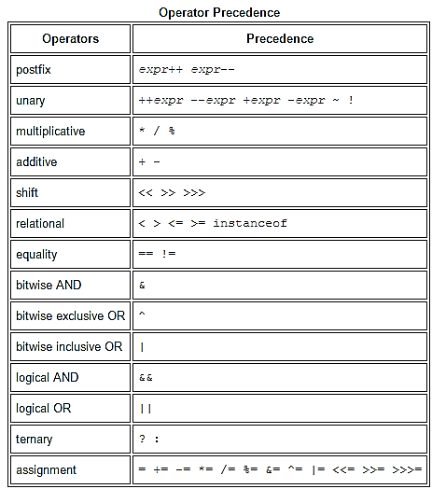
Introduction to Java
Operator Precedence
Operator precedence determines the order in which the operators in an expression are evaluated.

Slide 39
Introduction to Java
Self Assessment Questions
Which of these have highest precedence?
()
++
*
>>
Answer:

Slide 40
Introduction to Java
Self Assessment Questions
What should be expression1 evaluate to in using ternary operator as in this line? expression1 ? expression2 : expression3
Integer
Floating – point numbers
Boolean
None of the mentioned
Answer:

Slide 41
Introduction to Java
Self Assessment Questions
What should be expression1 evaluate to in using ternary operator as in this line? expression1 ? expression2 : expression3
Integer
Floating – point numbers
Boolean
None of the mentioned
Answer:

Slide 42
Introduction to Java
Document Links
Topics | URL | Notes
Operators in Java | https://data-flair.training/blogs/java-operators/ | This link explains about operators and its types.
Types of operators in Java | http://toolsqa.com/java/basic-java-programming/operators/ | This link explains types of operators with examples.
Operator precedence | https://www.programiz.com/java-programming/operator-precedence | This document will explain about operator precedence

Slide 43
Introduction to Java
Video Links
Topics | URL | Notes
Operators in Java | https://www.youtube.com/watch?v=TL7tdNp0raE | This video explains types of operators in java
Unary operators | https://www.youtube.com/watch?v=Ep_Qkcailrw | This video explains unary operators with examples
Operator precedence | https://www.youtube.com/watch?v=39i4JBKDKc8 | This video explains about operator precedence and associatively

Slide 44
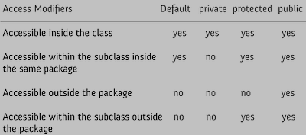
Introduction to Java
Access Specifiers in java
Access Specifiers (also known as Visibility Specifiers) regulate access to classes, fields and methods in Java.
In java we have four Access Specifiers and they are listed below:
public
Private
Protected
default (no specifier)

Slide 45
Introduction to Java
Type Casting
Type casting is used to assign a value of one type of a variable to another type.
Casting in other words is an instruction to compiler to convert one type to another.
It helps java not only to perform only arithmetic operation on pairs of values of the same type but performs operations on mixed type too.
There are two types of type casting:
Widening casting
Narrowing casting

Slide 46
Introduction to Java
Type Casting example:
Public class main
{
Public Static void main(string args[] )
{
int var1=12; //
double var2=15.2;
double result = var1+var2; //type casting
System.out.println(“the sum is” +result)
}
}

Slide 47
Introduction to Java
Self Assessment Questions
Which of these access specifiers must be used for main() method?
private
public
protected
none of the mentioned
Answer:

Slide 48
Introduction to Java
Self Assessment Questions
Which of these is used to access member of class before object of that class is created?
Public
Private
Static
Protected
Answer:

Slide 49
Introduction to Java
Self Assessment Questions
Which of the following automatic type conversion will be possible?
short to int
byte to int
int to long
long to int
Answer:

Slide 50
Introduction to Java
Document Links
Topics | URL | Notes
Access Specifiers in java | http://www.wideskills.com/java-tutorial/introduction-to-java-access-modifiers | This link explains how different access specifier used in programs.
Type Casting | https://javarevisited.blogspot.com/2012/12/what-is-type-casting-in-java-class-interface-example.html | This link explain type casting of different variables.

Slide 51
Introduction to Java
Video Links
Topics | URL | Notes
Type casting | https://www.youtube.com/watch?v=xfT2lS1glEY | This video link demonstrate type casting with examples
Access specifiers | https://www.youtube.com/watch?v=THQYqxJDqRI | This video demonstrate access specifiers with examples

Slide 52
Introduction to Java
String
In java strings are object which represent consequence of characters.
String class is used to create string object.
Example,
char[] ch={'j','a','v','a',‘w',‘o',‘r',‘l',‘d'};
String s=new String(ch);
(Or)
String s="javaworld";
There are two ways to create String object:
By string literal
By new keyword

Slide 53
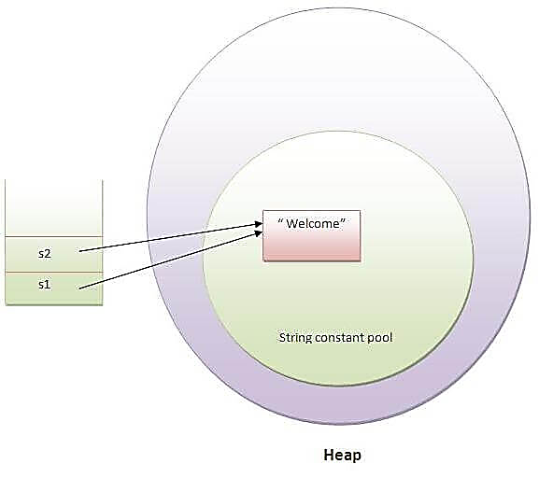
Introduction to Java
By using String literal
Java String literal is created by using double quotes.
Example: String s="welcome";
Each time you create a string literal, the JVM checks the string constant pool first.
Example :
String s1="Welcome";
String s2="Welcome"; //will not create new instance

Slide 54
Introduction to Java
By new keyword
We can create an object to String class by allocating memory dynamically using new operator. This is just like creating an object to any class.
Example: String s=new String("Welcome");//creates two objects and one reference variable
In such case, JVM will create a new string object in normal (non pool) heap memory and the literal "Welcome" will be placed in the string constant pool. The variable s will refer to the object in heap (non pool).

Slide 55
Introduction to Java
String Example:
public class StringExample{
public static void main(String args[]){
String s1="java";//creating string by java string literal
char ch[]={'s','t','r','i','n','g','s'};
String s2=new String(ch);//converting char array to string
String s3=new String("example");//creating java string by new keyword
System.out.println(s1);
System.out.println(s2);
System.out.println(s3);
}
}

Slide 56
Introduction to Java
Immutable
In java, String objects are immutable, immutable means unmodified or unchanged.
Once string object is created its data or state it can’t be changed but new string object can be created.
For mutable string, you can use StringBuffer and StringBuilder classes.
Advantage : Less memory
Disadvantage: Less efficient

Slide 57
Introduction to Java
Java String Class Methods
substring(int begin):
Returns substring from begin index to end of the string.
Example: String s=“Welcome”;
System.out.pintln(s.substring(2,4));
equals():
To perform content comparision where case is important.
Example: String s=“java”;
System.out.println(s.equals(“java”));

Slide 58
Introduction to Java
Java String Class Methods (Cont..)
concat()
Adding two string we use this method
Example: String s=“programming”;
s=s.concat(“software”);
System.out.Println(s);
int length();
Returns the number of characters in the string
Example: “problem”.length();
char charAt(i);
Returns the char at postion i.
Example: “window”.charAt(2);

Slide 59
Introduction to Java
Self Assessment Questions
Which of these operators can be used to concatenate two or more String objects?
+
+=
&
||
Answer:

Slide 60
Introduction to Java
Self Assessment Questions
Which of these method of class String is used to obtain length of String object?
get()
Sizeof()
lengthof()
length()
Answer:

Slide 61
Introduction to Java
Self Assessment Questions
Which of these constructors is used to create an empty String object?
String()
String(void)
String(0)
None of the mentioned
Answer:

Slide 62
Introduction to Java
Document Links
Topics | URL | Notes
String manipulation | https://www.guru99.com/javastrings.html | This document explains about various string manipulations with examples

Slide 63
Introduction to Java
Video Links
Topics | URL | Notes
Strings in Java | https://www.youtube.com/watch?v=4l50UaPca7Y | This video will explain different string class methods and immutable strings.

Slide 64
Introduction to Java
Control Statement in Java
Control statements alters the flow of execution and provide better control to the programmer on the flow of execution.
The following control statements are available in Java:
if ...else statement
do...while loop
while loop
for loop
for-each loop
switch statement
break statement
continue statement

Slide 65
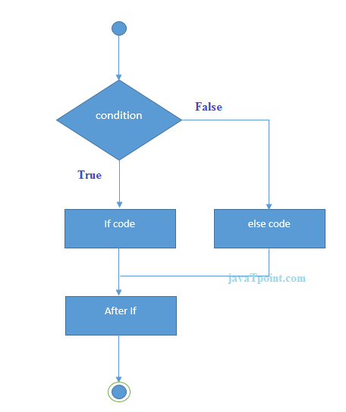
Introduction to Java
If else Statement
This statement is used to perform a task depending on whether a given condition is true or false.
Syntax:
if(condition)
{
//code if condition is true
}
else
{
//code if condition is false
}

Slide 66
Introduction to Java
If else Statement example:
public class Sample {
public static void main(String[] args) {
int number=13;
if(number%2==0){ // if the condition is true it returns even number
System.out.println("even number");
}else{ // if not it returns odd number
System.out.println("odd number");
}
}
}

Slide 67
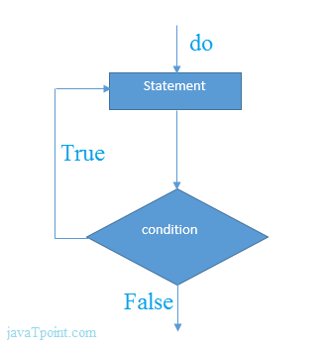
Introduction to Java
Do..while Statement:
This loop is used when there is a need to repeatedly execute a group of statements as long as a condition is true.
Syntax:
do{
statements;
}
while(condition);

Slide 68
Introduction to Java
Do..while Statement example:
public class Sample {
public static void main(String[] args) {
int i=1;
do{
System.out.println(i);
i++;
}while(i<=10);
}
}

Slide 69
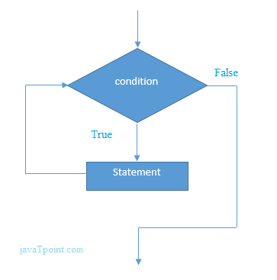
Introduction to Java
While statement
The functioning of this loop is also similar to do...while loop.
This loop repeats a group of statements as long as a condition is true, once the condition is false, the loop is terminated.
Syntax:
while(condition)
{
Statement;
}

Slide 70
Introduction to Java
While loop example:
public class Sample {
public static void main(String[] args) {
int i=1;
while(i<=10){ // while condition is true it executes the statement
System.out.println(i);
i++;
}
}
}

Slide 71
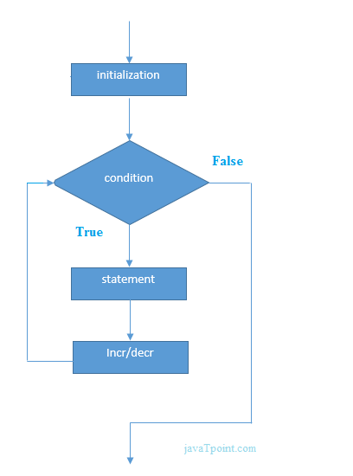
Introduction to Java
For statement
The for loop is also same as do...while or while loop, but it is more compact syntactically.
The for loop executes a group of statements as long as a condition is true.
Syntax: for(expression1; expression2; expression3 )
{
Statement;
}
Example: for(int x=1; x< =10 ; x++)
{
System.out.println(x);
}

Slide 72
Introduction to Java
For each statement
The for-each loop repeatedly executes a group of statements for each element of the collection.
It executes as many times as there are number of elements in the collection.
Syntax:
for(var : collection)
{
Statement;
}

Slide 73
Introduction to Java
For each example
public class ForEachExample {
public static void main(String[] args) {
int arr[]={12,23,44,56,78};
for(int i:arr) // for each condition
{
System.out.println(i);
}
}
}

Slide 74
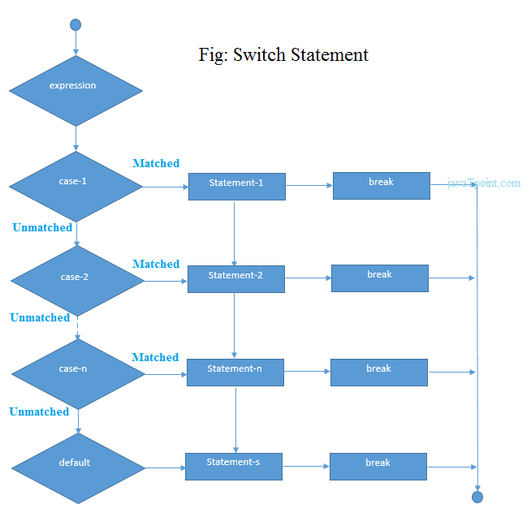
Introduction to Java
Switch statement:
When there are several options and we have to choose only one option from the available ones, we can use switch statement.
Depending on the selected option, a particular task can be performed.
Syntax: switch(expression){
case value1:
//code to be executed;
break; //optional
case value2:
//code to be executed;
break; //optional
. .....
default:
code to be executed if all cases are not matched;
}

Slide 75
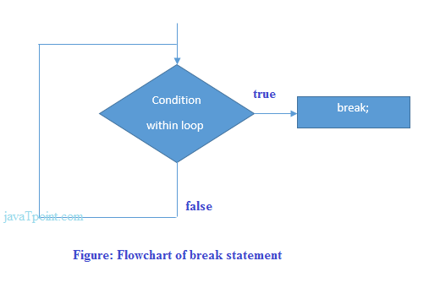
Introduction to Java
Break statement:
The break statement can be used in 3 ways:
Break is used inside a loop to come out of it.
Break is used inside the switch block to come out of the switch block.
Break can, be used in nested blocks to go to the end of a block. Nested blocks represent a block written within another block.
Syntax:
jump-statement;
break;

Slide 76
Introduction to Java
Continue statement:
Continue is used inside a loop to repeat the next iteration of the loop.
When continue is executed, subsequent statements in the loop are not executed and control of execution goes back to the next repetition of the loop.
Syntax: continue;
Example:
public class ContinueExample {
public static void main(String[] args) {
for(int i=1;i<=10;i++){
if(i==5){
continue;
}
System.out.println(i);
} } }

Slide 77
Introduction to Java
Self Assessment Questions
Which of these selection statements test only for equality?
If
Switch
if & switch
none of the mentioned
Answer:

Slide 78
Introduction to Java
Self Assessment Questions
Which of these are selection statements in Java?
if()
for()
Continue
break
Answer:

Slide 79
Introduction to Java
Self Assessment Questions
Which of the following loops will execute the body of loop even when condition controlling the loop is initially false?
do-while
while
for
none
Answer:

Slide 80
Introduction to Java
Document Links
Topics | URL | Notes
Control Statements in java | https://www.csharpcorner.com/UploadFile/e4b959/control-statement-in-java-with-example/? | This document explains about control statement in java.

Slide 81
Introduction to Java
Video Links
Topics | URL | Notes
For loop | https://unacademy.com/lesson/java-programming-lecture-8-loops-in-java-the-for-loop/VBI19JVM | This video will explain where to use for loops
while loop | https://unacademy.com/lesson/loops-in-java-while-loop-do-while-loop-preventing-endless-loops/ZD9HLQWM | This video will explain about while loops, do while loop and preventing endless loop statement
Continue and break statement | https://unacademy.com/lesson/loops-in-java-break-and-continue/VZ5MU42R | This video explains about break and continue control statements and its applications

Slide 82
Introduction to Java
Methods
Java methods are similar to what is called functions or procedures in other programming languages .
A method is a group of Java statements that perform some operation on some data, and may or may not return a result.
Example of method:
public static int function(int n1, int n2)
{
int min; if (n1 > n2) min = n2;
else min = n1;
return min;
}

Slide 83
Introduction to Java
Static method
Static method is a method that does not act upon instance variables of a class.
A static method is declared by using the keyword ”static”.
Static methods are called using Classname .methodname().

Slide 84
Introduction to Java
Static method example:
class Calculate{
static int cube(int x){
return x*x*x;
}
public static void main(String args[]){
int result=Calculate.cube(5);
System.out.println(result);
}
}

Slide 85
Introduction to Java
Static block
A static block is a block of statement declared as static.
Syntax: static
{
Statement;
}
JVM executes a static block on highest priority basis.

Slide 86
Introduction to Java
Static block example:
class Sample
{
static{
System.out.println("static block is invoked");
}
public static void main(String args[]){
System.out.println("Hello main");
}
}

Slide 87
Introduction to Java
Self Assessment Questions
What is the return type of a method that does not returns any value?
Int
Float
Void
Double
Answer:

Slide 88
Introduction to Java
Self Assessment Questions
Which of the following is a method having same name as that of it’s class?
Finalize
Delete
Class
Constructor
Answer:

Slide 89
Introduction to Java
Self Assessment Questions
Which method can be defined only once in a program?
main method
finalize method
static method
private method
Answer:

Slide 90
Introduction to Java
Document Links
Topics | URL | Notes
Methods in java | https://www.programiz.com/java-programming/methods https://data-flair.training/blogs/java-method/ | This document explain methods, declaration of methods, initialization of methods.
Static methods and Static block | https://beginnersbook.com/2013/04/java-static-class-block-methods-variables/ | This document explain about static method, static variables and static blocks.

Slide 91
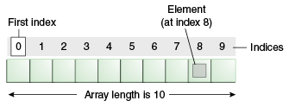
Introduction to Java
Array in java
Array is a collection of similar type of elements that have contiguous memory location.
Java array is an object the contains elements of similar data type. It is a data structure where we store similar elements. We can store only fixed set of elements in a java array.
Advantages: Code Optimization, Random access
Disadvantage: Size Limit

Slide 92
Introduction to Java
Video Links
Topics | URL | Notes
Methods in java | https://www.youtube.com/watch?v=yi0vT3M3gCE | This video explain how to declare a methods with example
Static methods and Static block | https://www.youtube.com/watch?v=jqpZ7qcsGOE | This video demonstrate static methods and static blocks.

Slide 93
Introduction to Java
Arrays in Java
Syntax for Array:
dataType[] arr; (or)
dataType []arr; (or)
dataType arr[];
Instantiation of an Array in java:
arrayRefVar=new datatype[size];
There are two types of array:
Single Dimensional Array
Multidimensional Array

Slide 94
Introduction to Java
Array example program:
class Testarray{
public static void main(String args[]){
int a[]=new int[5];//declaration and instantiation
a[0]=10;//initialization
a[1]=20;
a[2]=70;
a[3]=40;
a[4]=50; //printing array
for(int i=0;i<a.length;i++)//length is the property of array
System.out.println(a[i]);
}}

Slide 95
Introduction to Java
Self Assessment Questions
Which of these standard collection classes implements all the standard functions on list data structure?
Array
LinkedList
HashSet
AbstractSet
Answer:

Slide 96
Introduction to Java
Self Assessment Questions
Which of these is necessary to specify at time of array initialization?
Row
Column
Both Row and Column
None of the mentioned
Answer:

Slide 97
Introduction to Java
Self Assessment Questions
Which of these operators is used to allocate memory to array variable in Java?
Malloc
Alloc
New
new malloc
Answer:

Slide 98
Introduction to Java
Document Links
Topics | URL | Notes
Arrays | https://data-flair.training/blogs/java-array/ | This document explains arrays, declaration of array, Instantiating an Array in java, Accessing Java Array Elements using for Loop and f. Java Multidimensional Array

Slide 99
Introduction to Java
Video Links
Topics | URL | Notes
Arrays with examples | https://unacademy.com/lesson/arrays-in-java/DUKAU2KR | Explain arrays with examples.

Slide 100
Introduction to Java
Assignment
You need to answer below sets of problem. These sets of questions are meant for testing unit I.
Explain OOPs concepts with example.
In Java classes, what are various access for specifiers.
Give the purpose of static variables and static methods.
Difference of break statement and continue statement?
Difference of float variables and double variables in Java.
Can you declare that the main method in Java of the class as a private?
What is the meaning of ternary operator and provide example?
Explain arrays with example.
Write a program in Java to print Fibonacci series up to given number? Write both iterative and recursive version.
Write a program in Java to reverse any String without using String Buffer?

Slide 101
Introduction to Java
Summary
Java is a high level, object-oriented, platform independent language.
Java, unlike some languages before it allows for the use of words and commands instead of just symbols and numbers. Java also allows for the creation of advanced data types called objects which represent real world things like a chair or a computer where you can set the attributes of these objects and things they do.
Java is very flexible - it can be used to develop software as well as applets (small programs that run on webpages). But the flexibility does not end there, because you can run the same Java programs on various operating systems without having to rewrite the code (unlike some other languages such as C and C++) thanks to the Java run-time environment which interprets Java code and tells the operating system what to do.
Learning Java serves as a good introduction to software development.

Slide 102
Introduction to Java
E-Book Links
Topics | URL
Java The Complete Reference, Seventh Edition | http://iiti.ac.in/people/~tanimad/JavaTheCompleteReference.pdf
Introduction to Programming Using Java, Y. Daniel Liang:, 6th Edition, Pearson Education, 2007. | http://www.iitk.ac.in/esc101/share/downloads/javanotes5.pdf
Jim Keogh: J2EE The Complete Reference, Tata McGraw Hill, 2007. | https://web.iiit.ac.in/~nagarjuna.psug08/J2ME%20-%20The%20Complete%20Reference.pdf
Core Java Integrated approaches by nageshwara Rao 2009 edition. | https://dlscrib.com/corejavabynageswararaopdffreedownload_58e07938dc0d6067718970ed_pdf.html

